Slide 1
CPU Scheduling

Slide 2
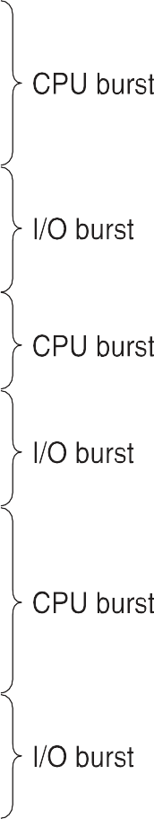


Basic Concepts
Maximum CPU utilization obtained with multiprogramming
CPU–I/O Burst Cycle – Process execution consists of a cycle of CPU execution and I/O wait
CPU burst followed by I/O burst

Slide 3
CPU Scheduler
Short-term scheduler selects from among the processes in ready queue, and allocates the CPU to one of them
Queue may be ordered in various ways
CPU scheduling decisions may take place when a process:
Switches from running to waiting state
Switches from running to ready state
Switches from waiting to ready
Terminates
Scheduling under 1 and 4 is non-preemptive
All other scheduling is preemptive

Slide 4
Dispatcher
Dispatcher module gives control of the CPU to the process selected by the short-term scheduler; this involves:
switching context
switching to user mode
jumping to the proper location in the user program to restart that
program
Dispatch latency – time it takes for the dispatcher to stop one process and start another running

Slide 5
Scheduling Criteria
CPU utilization – keep the CPU as busy as possible
Throughput – # of processes that complete their execution per time unit
Turnaround time – amount of time to execute a particular process
Waiting time – amount of time a process has been waiting in the ready queue
Response time – amount of time it takes from when a request was submitted until the first response is produced, not output (for time-sharing environment)

Slide 6
Notation
' N' Processes (P1.....Pn)
Arrival Time (AT) = A_{i}
Burst Time (BT) = B
Turnaround Time (TAT) = C_{i} - A_{i}
AvgTAT = 1/n ∑C_{i} - A_{i}
i=1
i
Completion Time (CT) = C_{i}
n
i
WaitingTime (WT) = TAT - BT = C - A − BT
i
i
Avg WT = 1/n ∑C_{i} - A_{i} − B_{i}
i=1
n

Slide 7
Scheduling Algorithm Optimization Criteria
Max CPU utilization
Max throughput
Min turnaround time
Min waiting time
Min response time

Slide 8
Scheduling Algorithms
Classification of scheduling algorithms is given in the table below
CPU / Processor Scheduling Algorithms
Non Preemptive Algorithms |  |  | Preemptive Algorithms
First-Come First-Serve (FCFS) | Shortest Job First (SJF) | Priority Non Preemptive (P-NP) | Shortest Remaining Time First (SRTF) | Priority Preemptive (Pri-P) | Round Robin (RR)
Other classes of CPU scheduling algorithms includes
Multilevel Queue Scheduling
Multilevel Feedback Queue scheduling
Multiple –Processes Scheduling
Real-Time Scheduling

Slide 9
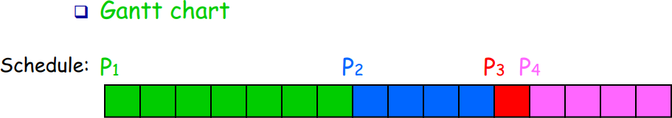
Gantt chart
It is used to represent the scheduling of processes graphically
It is a rectangular time scale diagram with x-axis depicting the timeline
Process- ids of processes allocated the CPU for a particular time periods is indicated in that rectangular slot

Slide 10
First- Come, First-Served (FCFS) Scheduling
Concept - Process that requests the CPU first is allocated the CPU first.
Mode: Non-Preemptive
Criteria: Arrival Time
Working -
Process requests are kept in ready queue in FIFO order i.e. ready queue is maintained as FIFO queue.
When a new process enters the queue, its PCB is linked onto the tail/rear of the queue.
When CPU is free, it is allocated to the process that is at the head / front of the queue.

Slide 11
First- Come, First-Served (FCFS) Scheduling
Consider the following set of processes that arrive at time 0, in the order PI, P2, P3, with CPU-burst time in milliseconds given below (Avg TAT Avg WT)
Process
P₁ P₂ P₃
Burst Time
24
3
3
Gantt chart
P₁ | P₂ | P₃
0
24
27
30

Slide 12





Avg WT ?
P₁ | P₂ | P₃
Avg TAT ?
0
24
27
30
Turnaround Time (TAT) = C_{i} - A_{i}
AvgTAT = 1/n ∑C_{i} - A_{i}
i=1
WaitingTime (WT) = TAT - BT = C_{i} - A_{i} − BT
Avg WT = 1/n ∑C_{i} - A_{i} − B_{i}
i=1
n
n
Process id | Burst Time (BT) | Arrival Time (AT) | Completion Time (CT) | TAT | WT
PI | 24 | 0 | 24 | 24 | 0
P2 | 3 | 0 | 27 | 27 | 24
P3 | 3 | 0 | 30 | 30 | 27
Average TAT = (24 + 27 + 30)/3 = 81 / 3 = 27 msec.
Average WT = (0 + 24 + 27 ) / 3 = 51/3 = 17 msec.

Slide 13
Example 2
Consider the Example 1 again but with process arriving in the order P2,P3, PI.
▪

Slide 14
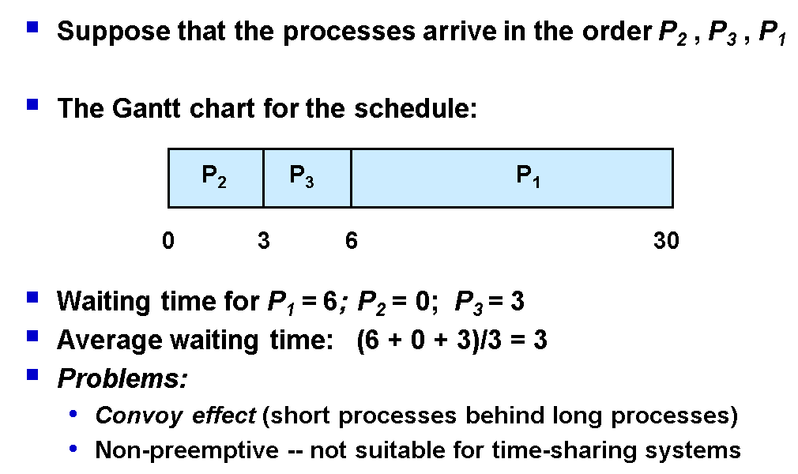
Convoy Effect :All other processes wait for the one big process to get off the CPU

Slide 15
Example 3
Process | Arrival Time | Burst Time
P1 | 0 | 8
P2 | 1 | 4
P3 | 2 | 9
P4 | 3 | 5

Slide 16
Process | Arrival Time | Burst Time
P1 | 0 | 8
P2 | 1 | 4
P3 | 2 | 9
P4 | 3 | 5
Initial Ready Queue
P1
P1
0
8

Slide 17
Process | Arrival Time | Burst Time
P1 | 0 | 8
P2 | 1 | 4
P3 | 2 | 9
P4 | 3 | 5
After 8 ms Ready Queue
P2 P3 P4
P1
P2
0
8
12

Slide 18
Process | Arrival Time | Burst Time
P1 | 0 | 8
P2 | 1 | 4
P3 | 2 | 9
P4 | 3 | 5
Ready Queue
P3 P4
P1
P2
P3
0
8
12
21

Slide 19
Process | Arrival Time | Burst Time
P1 | 0 | 8
P2 | 1 | 4
P3 | 2 | 9
P4 | 3 | 5
Ready Queue
P4
P1
P2
P3
0
8
12
21

Slide 20
Process | Arrival Time | Burst Time
P1 | 0 | 8
P2 | 1 | 4
P3 | 2 | 9
P4 | 3 | 5
Ready Queue
P1
P2
P3
P4
0
8
12
21
26

Slide 21
P1
P2
P3
P4
0
8
12
21
26
Turnaround Time (TAT) = C_{i} - A_{i}
AvgTAT = 1/n ∑C_{i} - A_{i}
i=1
WaitingTime (WT) = TAT - BT = C_{i} - A_{i} − BT
Avg WT = 1/n ∑C_{i} - A_{i} − B_{i}
i=1
n
Process | Arrival Time | Burst Time | Completion Time (CT) | TAT | WT
P1 | 0 | 8 | 8 | 8 | 0
P2 | 1 | 4 | 12 | 11 | 7
P3 | 2 | 9 | 21 | 19 | 10
P4 | 3 | 5 | 26 | 23 | 18
n
Average TAT = (8 + 11 + 19+23)/4 = 61/ 4 = 15.25 msec.
Average WT = (0 + 7+10 + 18) / 4 = 35/4 = 8.75 msec.

Slide 22
First-Come, First-Served (FCFS) Scheduling
Single FIFO ready queue
No-preemptive
Not suitable for timesharing systems
Simple to implement and understand

Slide 23
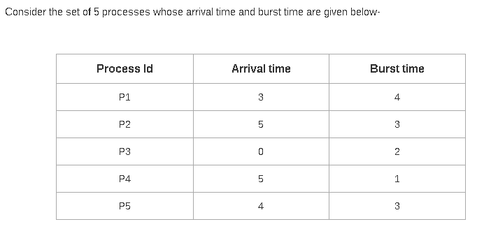

Assignment Questions

Slide 24
Shortest-Job-First (SJF) Scheduling
Concept - Allocate the CPU to the process with the smallest next CPU burst.
Mode :Non-Preemptive
Criteria :Burst Time
Working -
It associates with each process the length of its next CPU burst.
The CPU is allocated to the process with the smallest next CPU burst.
If two processes have the same next CPU bursts, FCFS is used to break the tie.

Slide 25
Shortest-Job-First (SJF) Scheduling
Consider the following set of processes that arrive at time 0, in the order PI, P2, P3, with CPU-burst time in milliseconds given below (Avg TAT Avg WT)
Process
P₁ P₂ P₃
Burst Time 24
3
3
P2
P3
P1
0
3
6
30

Slide 26
P2
Avg TAT ?
Avg WT ?
P3
P1
0
3
6
3
0
Turnaround Time (TAT) = C - A
i i
AvgTAT = 1/n ∑C_{i} - A_{i}
i=1
WaitingTime (WT) = TAT - BT = C_{i} - A_{i} − BT
Avg WT = 1/n ∑C_{i} - A_{i} − B_{i}
i=1
n
n
Process id | Burst Time (BT) | Arrival Time (AT) | Completion Time (CT) | TAT | WT
PI | 24 | 0 | 30 | 30 | 6
P2 | 3 | 0 | 3 | 3 | 0
P3 | 3 | 0 | 6 | 6 | 3
Average TAT = 39 / 3 = 13 msec.
Average WT = 9/ 3 = 3 msec.

Slide 27
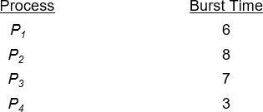
Example of SJF
SJF scheduling chart
P₄ | P₁ | P₃ | P₂
0
3
9
16
24

Slide 28
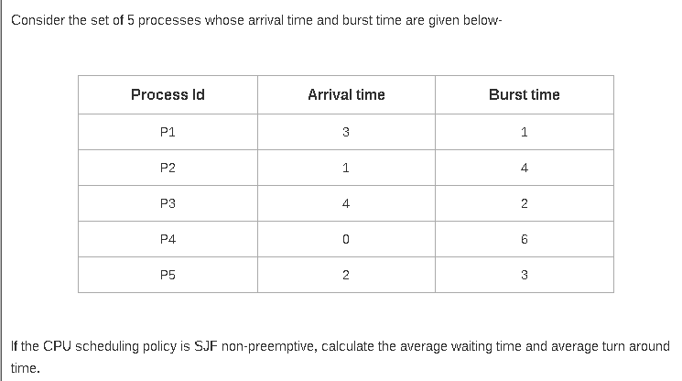
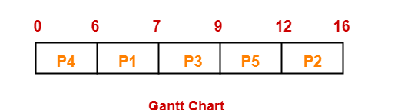

Slide 29
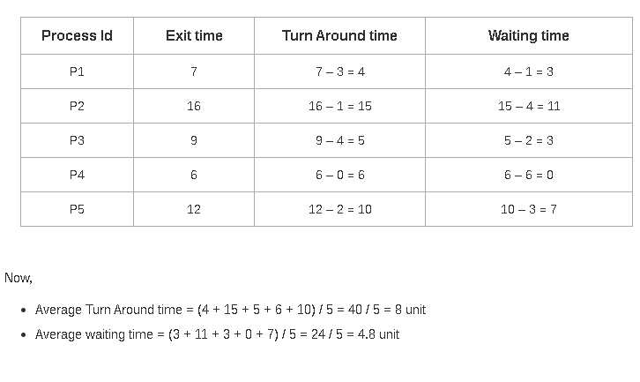

Slide 30
Observations
Also called as shortest next CPU burst scheduling.
It is provably the optimal scheduling algorithm.
It gives the minimum average waiting time for a given set of processes
Knowing the length of the next CPU request is difficult.
It can’t be implemented at short term scheduling level as it is difficult know the length of the next CPU burst.
SJF will result in the maximum Throughput

Slide 31
SJF with Prediction Techniques BT
Prediction Techniques
Static
Dynamic
1. Process size
1. Simple Averaging
2. Process Type
2. Exponential averaging

Slide 32
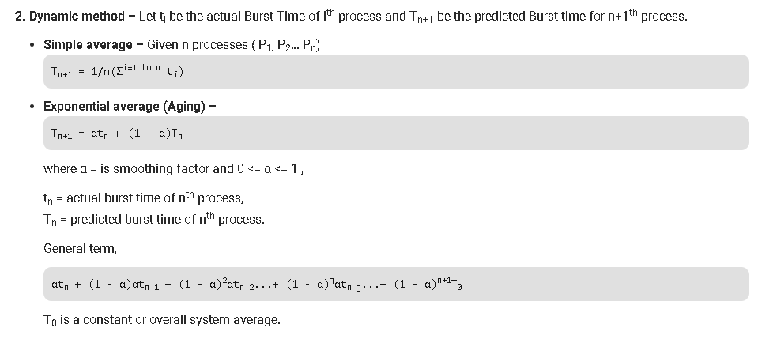

Slide 33
Determining Length of Next CPU Burst
Commonly, α set to ½
Preemptive version called shortest-remaining-time-first

Slide 34
Examples of Exponential Averaging
α =0
τ_{n+1} = τ_{n}
Recent history does not count
α =1
τ_{n+1} = α t_{n}
Only the actual last CPU burst counts
If we expand the formula, we get:
τ_{n+1} = α t_{n}+(1 - α)α t_{n -1} + …
+(1 - α )^{j} α t_{n -j} + …
+(1 - α )^{n +1} τ₀
Since both α and (1 - α) are less than or equal to 1, each
successive term has less weight than its predecessor

Slide 35

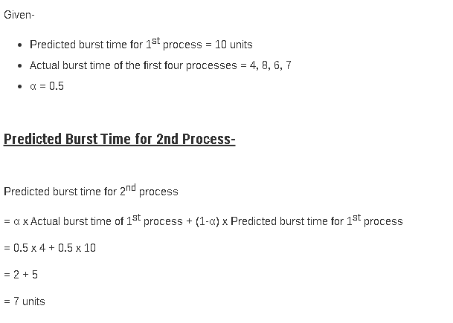

Slide 36
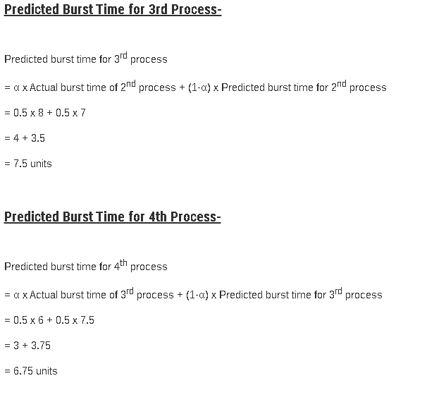

Slide 37
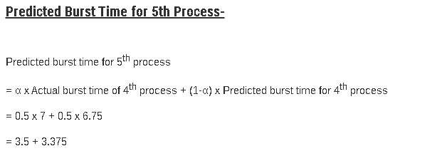

Slide 38


Assignment Questions
Process | Arrival Time | Burst Time
P1 | 0 | 20
P2 | 1 | 1
P3 | 2 | 1
Process | Arrival Time | Burst Time
P1 | 1 | 7
P2 | 2 | 5
P3 | 3 | 1
P4 | 4 | 2
P5 | 5 | 8

Slide 39
Shortest Remaining Time First / Shortest Job First Preemptive Scheduling (SRTF / SJFP)
Concept — Preempt the currently executing process, if the newly arrived process has shorter CPU burst time in comparison to the executing process.
Working -
Same as SJF except that it can cause preemption when a new process arrives.
If new arrived process has same CPU burst time as that of the executing process’s remaining CPU burst time,
the executing process is allowed to continue to avoid context switch overhead.
Has the overhead of context switch.

Slide 40
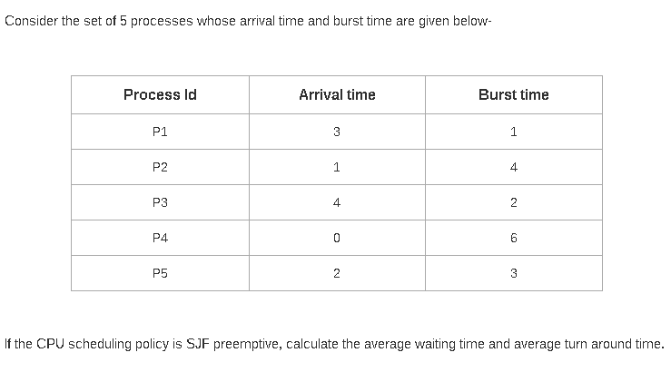
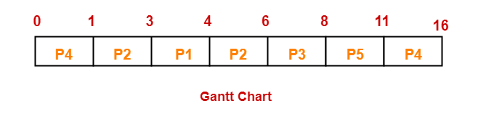

Slide 41
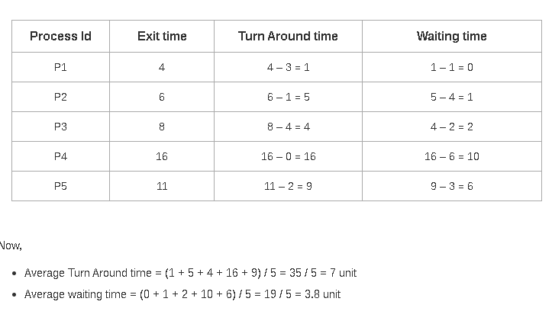

Slide 42
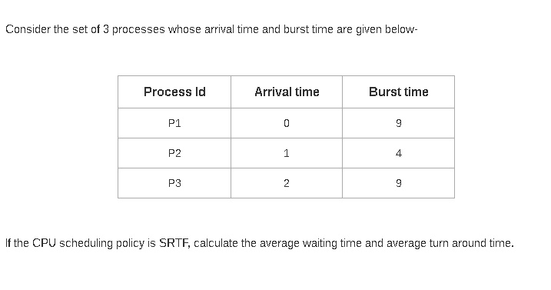
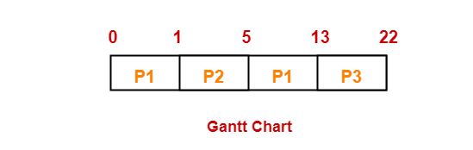

Slide 43
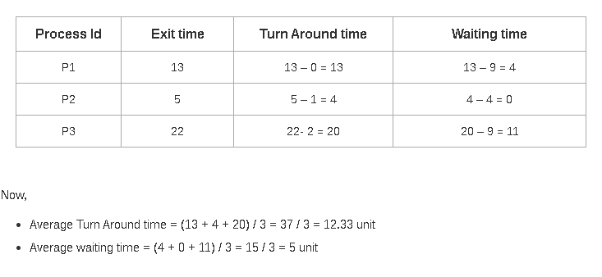

Slide 44
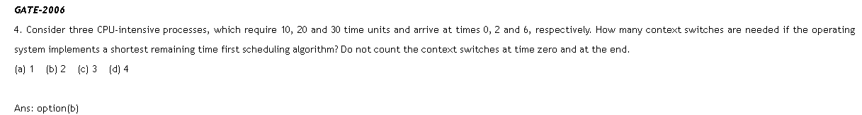

Slide 45
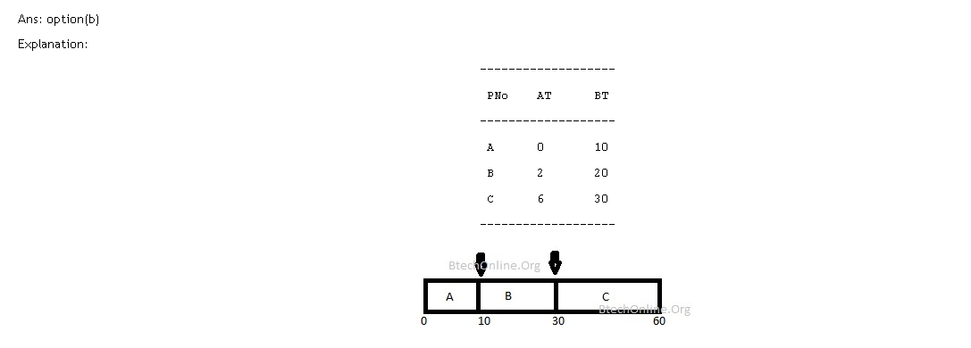

Slide 46
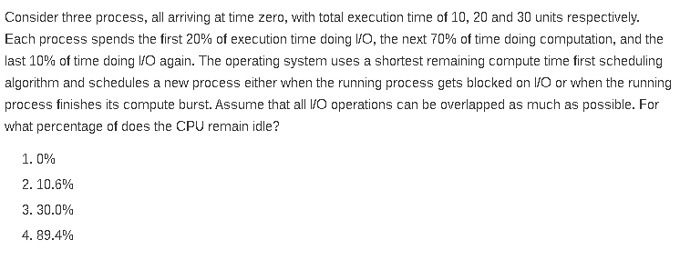

Slide 47
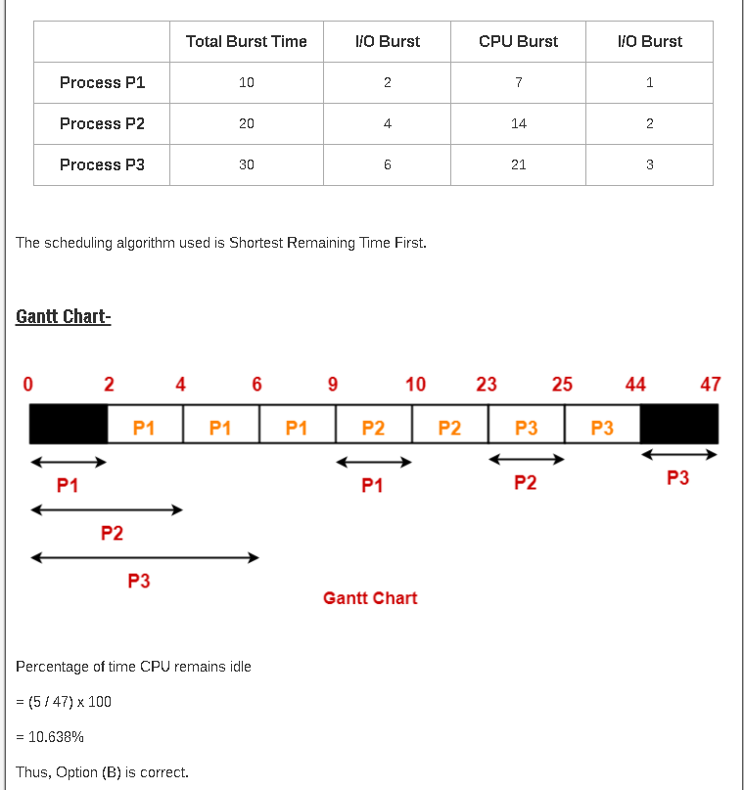

Slide 48
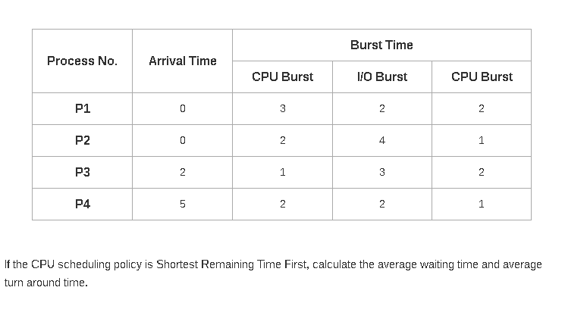

Slide 49
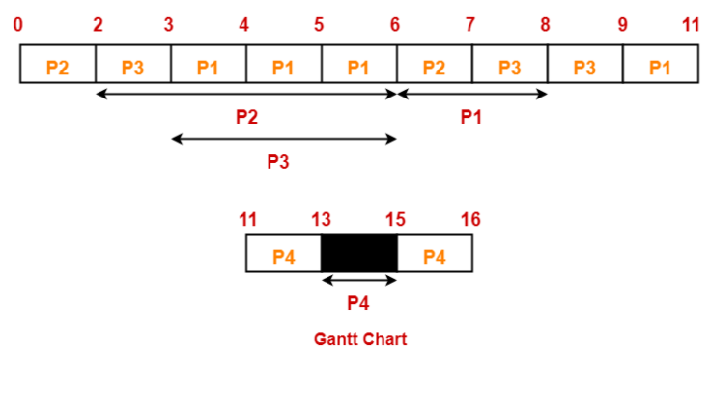

Slide 50
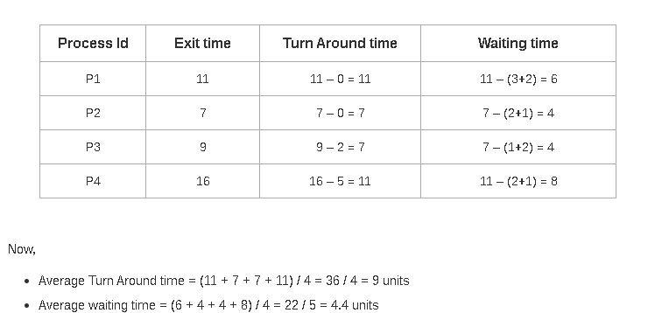

Slide 51
Example of Shortest-remaining-time-first
Now we add the concepts of varying arrival times and preemption to the analysis
Process Arrival Time Burst Time
P₁ |  | 0 |  | 8
P₂ |  | 1 |  | 4
P₃ |  | 2 |  | 9
P₄ |  | 3 |  | 5
Preemptive SJF Gantt Chart
P₁ | P₂ | P₄ | P₁ | P₃
0
1
5
10
17
26

Slide 52
Example 2 (Find ThroughPut)
Process | Arrival Time | Burst Time
P1 | 0 | 7
P2 | 1 | 5
P3 | 2 | 3
P4 | 3 | 1
P5 | 4 | 2
P6 | 5 | 1
Schedulelength(L) = Max(C_{i} ) − Min(A_{i} ) Through Put = N/L

Slide 53
Priority Scheduling
A priority number (integer) is associated with each process
The CPU is allocated to the process with the highest priority (smallest integer ≡ highest priority)
Preemptive
Nonpreemptive
Problem ≡ Starvation – low priority processes may never execute
Solution ≡ Aging – as time progresses increase the priority of the process

Slide 54
Priority Scheduling
Concept - Priorities are associated with processes, CPU is allocated to the process with highest priority.
Working
Processes are kept in the ready queue in order of their priorities, whether all processes arrive at the same time or have different times.
The CPU is allocated to the process with the highest priority.
If two processes have the same priority (Equal priority), FCFS is used to break the tie.

Slide 55
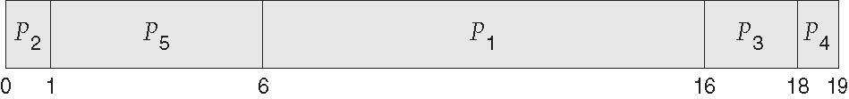
Example of Priority Scheduling
Process Burst Time Priority
P₁ | 10 | 3
P₂ | 1 | 1
P₃ | 2 | 4
P₄ | 1 | 5
P₅ | 5 | 2
Priority scheduling Gantt Chart

Slide 56






Avg TAT ?
Avg WT ?
RT for p5 is ?
Turnaround Time (TAT) = C_{i} - A_{i}
AvgTAT = 1/n ∑C_{i} - A_{i}
i=1
WaitingTime (WT) = TAT - BT = C_{i} - A_{i} − BT
Avg WT = 1/n ∑C_{i} - A_{i} − B_{i}
i=1
n
n
Process id | Burst Time (BT) | Arrival Time (AT) | Completion Time (CT) | TAT | WT | RT
P1 | 10 | 0 | 16 | 16 | 6 | 6
P2 | 1 | 0 | 1 | 1 | 0 | 0
P3 | 2 | 0 | 18 | 18 | 16 | 16
P4 | 1 | 0 | 19 | 19 | 18 | 18
P5 | 5 | 0 | 6 | 6 | 1 | 1
Average TAT = 39 / 3 = 13 msec.
Average WT = 9/ 3 = 3 msec.
Where
ST = Schedule Time

Slide 57
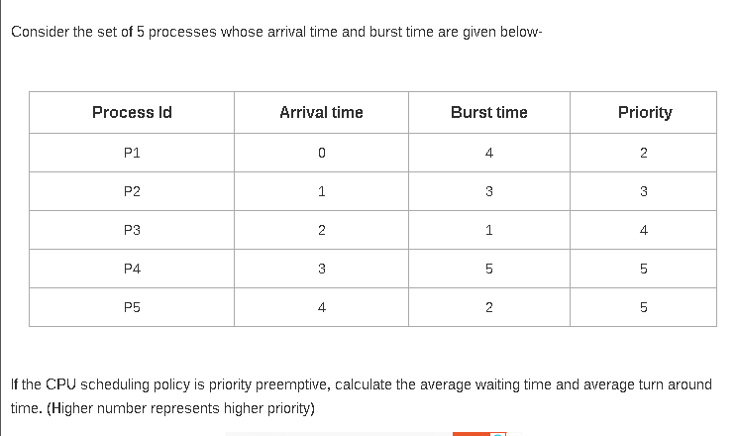

Slide 58
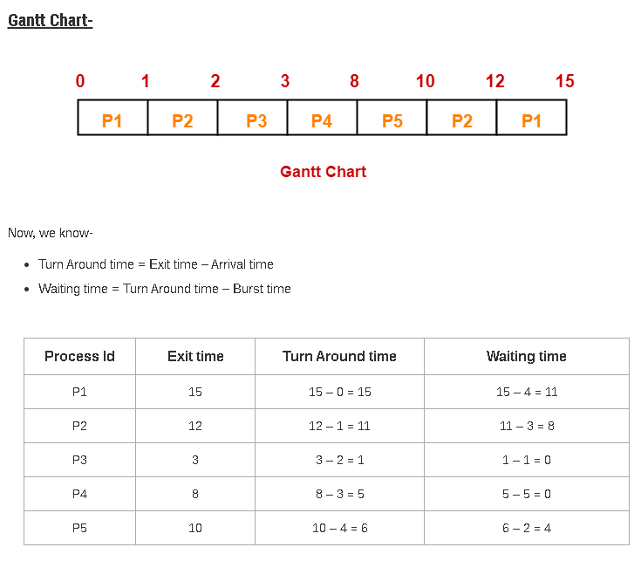

Slide 59
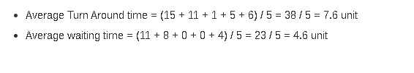

Slide 60
Example 2 (Preemptive)
Pno | Priority | AT | BT
P1 | 2(L) | 0 | 4
P2 | 4 | 1 | 2
P3 | 6 | 2 | 3
P4 | 10 | 3 | 4
P5 | 8 | 4 | 1
P6 | 12 (H) | 5 | 4
P7 | 9 | 6 | 6

Slide 61
Arrival Time
P1 P2 P3 P4 P5 P6 P7
Pno | Priority | AT | BT
P1 | 2(L) | 0 | 4
P2 | 4 | 1 | 2
P3 | 6 | 2 | 3
P4 | 10 | 3 | 4
P5 | 8 | 4 | 1
P6 | 12 (H) | 5 | 4
P7 | 9 | 6 | 6
P1 P2 P3 P4 P5 P6
P1 P2 P3 P4 P5
3
P1 P2 P3 P4
P1 P2 P3
P1 P2
P1
0 |  | 1 |  | 2 |  | 3 |  | 4 |  | 5 |  | 6
P1
0
1

Slide 62
Arrival Time
P1 P2 P3 P4 P5 P6 P7
Pno | Priority | AT | BT
P1 | 2(L) | 0 | 3
P2 | 4 | 1 | 2
P3 | 6 | 2 | 3
P4 | 10 | 3 | 4
P5 | 8 | 4 | 1
P6 | 12 (H) | 5 | 4
P7 | 9 | 6 | 6
P1 P2 P3 P4 P5 P6
P1 P2 P3 P4 P5
P1 P2 P3 P4
1
P1 P2 P3
P1 P2
P1
0 |  | 1 |  | 2 |  | 3 |  | 4 |  | 5 |  | 6
P1
P2
0
1
2

Slide 63
Arrival Time
P1 P2 P3 P4 P5 P6 P7
Pno | Priority | AT | BT
P1 | 2(L) | 0 | 3
P2 | 4 | 1 | 1
P3 | 6 | 2 | 3
P4 | 10 | 3 | 4
P5 | 8 | 4 | 1
P6 | 12 (H) | 5 | 4
P7 | 9 | 6 | 6
P1 P2 P3 P4 P5 P6
P1 P2 P3 P4 P5
P1 P2 P3 P4
P1 P2 P3
P1 P2
P1
2
0 |  | 1 |  | 2 |  | 3 |  | 4 |  | 5 |  | 6
P1
P2
P3
0
1
2
3

Slide 64
Arrival Time
P1 P2 P3 P4 P5 P6 P7
Pno | Priority | AT | BT
P1 | 2(L) | 0 | 3
P2 | 4 | 1 | 1
P3 | 6 | 2 | 2
P4 | 10 | 3 | 4
P5 | 8 | 4 | 1
P6 | 12 (H) | 5 | 4
P7 | 9 | 6 | 6
P1 P2 P3 P4 P5 P6
P1 P2 P3 P4 P5
P1 P2 P3 P4
P1 P2 P3
P1 P2
P1
3
0 |  | 1 |  | 2 |  | 3 |  | 4 |  | 5 |  | 6
P1
P2
P3
P4
0
1
2
3
4

Slide 65
Arrival Time
P1 P2 P3 P4 P5 P6 P7
Pno | Priority | AT | BT
P1 | 2(L) | 0 | 3
P2 | 4 | 1 | 1
P3 | 6 | 2 | 2
P4 | 10 | 3 | 3
P5 | 8 | 4 | 1
P6 | 12 (H) | 5 | 4
P7 | 9 | 6 | 6
P1 P2 P3 P4 P5 P6
P1 P2 P3 P4 P5
P1 P2 P3 P4
P1 P2 P3
P1 P2
P1
2
0 |  | 1 |  | 2 |  | 3 |  | 4 |  | 5 |  | 6
P1
P2
P3
P4
P4
5
0
1
2
3
4

Slide 66
Arrival Time
P1 P2 P3 P4 P5 P6 P7
Pno | Priority | AT | BT
P1 | 2(L) | 0 | 3
P2 | 4 | 1 | 1
P3 | 6 | 2 | 2
P4 | 10 | 3 | 2
P5 | 8 | 4 | 1
P6 | 12 (H) | 5 | 4
P7 | 9 | 6 | 6
P1 P2 P3 P4 P5 P6
P1 P2 P3 P4 P5
P1 P2 P3 P4
P1 P2 P3
P1 P2
P1
0 |  | 1 |  | 2 |  | 3 |  | 4 |  | 5 |  | 6
0
P1
0 1
P2
2
P3
3
P4
4
P4
5
P6
9

Slide 67
Arrival Time
P1 P2 P3 P4 P5 P6
P1 P2 P3 P4 P5 P7
Pno | Priority | AT | BT
P1 | 2(L) | 0 | 3
P2 | 4 | 1 | 1
P3 | 6 | 2 | 2
P4 | 10 | 3 | 2
P5 | 8 | 4 | 1
P6 | 12 (H) | 5 | 0
P7 | 9 | 6 | 6
P1 P2 P3 P4 P5
P1 P2 P3 P4
P1 P2 P3
P1 P2
P1
0
0 |  | 1 |  | 2 |  | 3 |  | 4 |  | 5 |  | 6
P1
0 1
P2
2
P3
3
P4
4
P4
5
P6
9
P4
11

Slide 68
Pno | Priority | AT | BT
P1 | 2(L) | 0 | 3
P2 | 4 | 1 | 1
P3 | 6 | 2 | 2
P4 | 10 | 3 | 0
P5 | 8 | 4 | 1
P6 | 12 (H) | 5 | 0
P7 | 9 | 6 | 6
Arrival Time
P1 P2 P3 P4 P5 P6
P1 P2 P3 P5 P7
P1 P2 P3 P4 P5
P1 P2 P3 P4
P1 P2 P3
P1 P2
P1
0 |  | 1 |  | 2 |  | 3 |  | 4 |  | 5 |  | 6
0
P1
0 1
P2
2
P3
3
P4
4
P4
5
P6
9
P4 P7
11 17

Slide 69
Pno | Priority | AT | BT
P1 | 2(L) | 0 | 3
P2 | 4 | 1 | 1
P3 | 6 | 2 | 2
P4 | 10 | 3 | 0
P5 | 8 | 4 | 1
P6 | 12 (H) | 5 | 0
P7 | 9 | 6 | 0
Arrival Time
P1 P2 P3 P4 P5 P6
P1 P2 P3 P5
P1 P2 P3 P4 P5
P1 P2 P3 P4
P1 P2 P3
P1 P2
P1
0 |  | 1 |  | 2 |  | 3 |  | 4 |  | 5 |  | 6
0
P1
0 1
P2
2
P3
3
P4
4
P4
5
P6
9
P4 P7
11 17
P5
18

Slide 70
Pno | Priority | AT | BT
P1 | 2(L) | 0 | 3
P2 | 4 | 1 | 1
P3 | 6 | 2 | 2
P4 | 10 | 3 | 0
P5 | 8 | 4 | 0
P6 | 12 (H) | 5 | 0
P7 | 9 | 6 | 0
Arrival Time
P1 P2 P3 P4 P5 P6
P1 P2 P3 P4 P5
P1 P2 P3
P1 P2 P3 P4
P1 P2 P3
P1 P2
P1
0
0 |  | 1 |  | 2 |  | 3 |  | 4 |  | 5 |  | 6
P1
0 1
P2
2
P3
3
P4
4
P4
5
P6
9
P4 P7
11 17
P5
P3
18
20

Slide 71
Pno | Priority | AT | BT
P1 | 2(L) | 0 | 3
P2 | 4 | 1 | 1
P3 | 6 | 2 | 0
P4 | 10 | 3 | 0
P5 | 8 | 4 | 0
P6 | 12 (H) | 5 | 0
P7 | 9 | 6 | 0
Arrival Time
P1 P2 P3 P4 P5 P6
P1 P2 P3 P4 P5
P1 P2
P1 P2 P3 P4
0
P1 P2 P3
P1 P2
P1
0 |  | 1 |  | 2 |  | 3 |  | 4 |  | 5 |  | 6
P1
0 1
P2
2
P3
3
P4
4
P4
5
P6
9
P4 P7
11 17
P5
P3
P2
18
20
21

Slide 72
Pno | Priority | AT | BT
P1 | 2(L) | 0 | 3
P2 | 4 | 1 | 0
P3 | 6 | 2 | 0
P4 | 10 | 3 | 0
P5 | 8 | 4 | 0
P6 | 12 (H) | 5 | 0
P7 | 9 | 6 | 0
Arrival Time
P1 P2 P3 P4 P5 P6
P1 P2 P3 P4 P5
0
P1 P2 P3 P4
P1
P1 P2 P3
P1 P2
P1
0 |  | 1 |  | 2 |  | 3 |  | 4 |  | 5 |  | 6
P1
0 1
P2
2
P3
3
P4
4
P4
5
P6
9
P4 P7
11 17
P5
18
P3
20
P2
21
P1
24

Slide 73
P1
P2
P3
P4
P4
P6
P4
P7
0
1
2
3
4
5
9
11
17
P5
P3
P2
P1
18
20
21
24
Process id | Burst Time (BT) | Arrival Time (AT) | Completion Time (CT) | TAT | WT | RT
P1 | 4 | 0 | 24 | 24 | 20 | 0
P2 | 2 | 1 | 21 | 20 | 18 | 0
P3 | 3 | 2 | 20 | 18 | 15 | 0
P4 | 4 | 3 | 11 | 8 | 4 | 0
P5 | 1 | 4 | 18 | 14 | 13 | 13
P6 | 4 | 5 | 9 | 4 | 0 | 0
P7 | 6 | 6 | 17 | 11 | 5 | 5
Average TAT = 14.14 msec. Average WT = 10.71 msec.
Throughput =7/24 =0.29msec

Slide 74
Example 4
Pno | Priority | AT | CPU | I/O | CPU
P1 | 2 | 0 | 1 | 5 | 3
P2 | 3(L) | 2 | 3 | 3 | 1
P3 | 1(H) | 3 | 2 | 3 | 1

Slide 75
Round Robin (RR)
Each process gets a small unit of CPU time (time quantum q), usually 10-100 milliseconds. After this time has elapsed, the process is preempted and added to the end of the ready queue.
Timer interrupts every quantum to schedule next process
Performance
q large ⇒ FIFO
q small ⇒ q must be large with respect to context switch, otherwise overhead is
too high

Slide 76
Round Robin (RR)
Concept — CPU time (in units of time slice/ time quantum) is shared among the requesting processes in a round robin sequence.
Working -
A small unit of time called time slice / time quantum is defined. It is usually 10 to 100 msecs.
The ready queue is operated as a circular queue.
Processes in the ready queue are kept in FIFO order.
The scheduler picks the first process from the ready queue, at the same time sets a timer to interrupt at the end of the time slice and dispatches the process.
When the timer goes off, either the executing process completes and releases the CPU or requires more time thus requiring a Context Switch and is added to the tail of the queue.

Slide 77
Example of RR with Time Quantum = 4
Process
P₁ P₂ P₃
The Gantt chart is:
Burst Time 24
3
3
P₁ | P₂ | P₃ | P₁ | P₁ | P₁ | P₁ | P₁
0
4
7
10
14
18
22
26
30
Typically, higher average turnaround than SJF, but better response
q should be large compared to context switch time
q usually 10ms to 100ms, context switch < 10 usec

Slide 78
Example 1
Time Quantum = 2
Process Id | CPU Burst Time | Arrival Time
P1 | 6 | 0
P2 | 2 | 1
P3 | 4 | 2

Slide 79
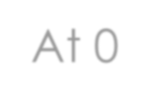
Process Id | CPU Burst Time | Arrival Time
P1 | 6 | 0
P2 | 2 | 1
P3 | 4 | 2
Queue
P1
At 0
Time Quantum = 2

Slide 80

Process Id | Arrival Time | CPU Burst Time
P1 | 0 | 6
P2 | 1 | 2
P3 | 2 | 4
Queue
4
At 0
Time Quantum = 2
P1
0
2

Slide 81

Queue P2 P3
Process Id | Arrival Time | CPU Burst Time
P1 | 0 | 4
P2 | 1 | 2
P3 | 2 | 4
After 2
Time Quantum = 2
P1
0
2

Slide 82

Queue P3 P1
Process Id | Arrival Time | CPU Burst Time
P1 | 0 | 4
P2 | 1 | 2
P3 | 2 | 4
0
After 4
Time Quantum = 2
P1 P2
0
2
4

Slide 83

Process Id | Arrival Time | CPU Burst Time
P1 | 0 | 4
P2 | 1 | 0
P3 | 2 | 4
Queue
P1
2
After 6
Time Quantum = 2
P1 P2
P3
0
2
4
6

Slide 84
Process Id | Arrival Time | CPU Burst Time
P1 | 0 | 4
P2 | 1 | 0
P3 | 2 | 2
Queue
P3
2
After 6
Time Quantum = 2
P1 P2
P3
P1
0
2
4
6
8

Slide 85
Process Id | Arrival Time | CPU Burst Time
P1 | 0 | 2
P2 | 1 | 0
P3 | 2 | 2
Queue
P3
After 6
Time Quantum = 2
P1 P2
P3
P1
0
2
4
6
8

Slide 86

Process Id | Arrival Time | CPU Burst Time
P1 | 0 | 6
P2 | 1 | 2
P3 | 2 | 4
Queue
Final
Time Quantum = 2
P1 P2
0 2 4
P3
P1
8
P3
P1
12
6
10

Slide 87
Example 2 [ Time Quantum = 3 ]
process - id | CPU Burst Time | Arrival Time
P1 | 5 | 5
P2 | 6 | 4
P3 | 7 | 3
P4 | 9 | 1
P5 | 2 | 2
P6 | 3 | 6

Slide 88

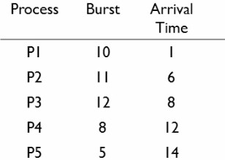
Example 3 [ Time Quantum = 5 ]
Assignment Question

Slide 89
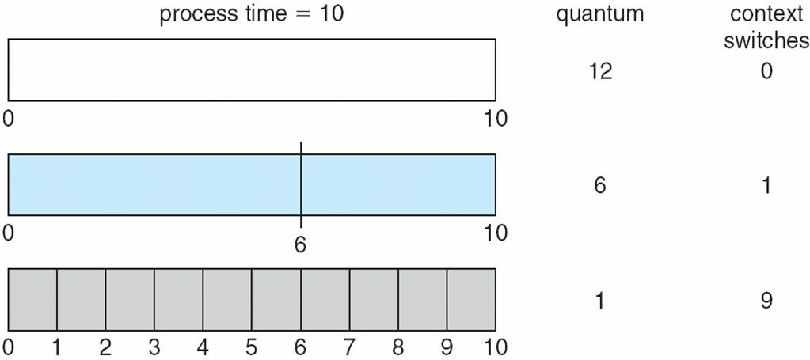
Time Quantum and Context Switch Time

Slide 90
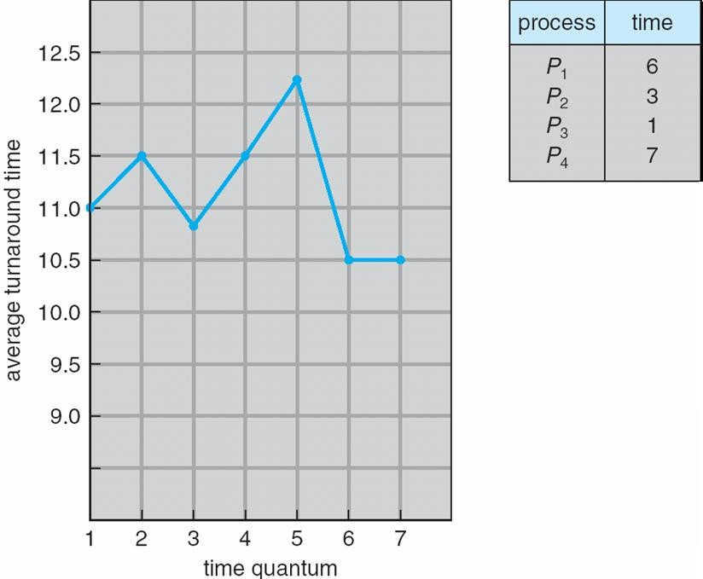
Turnaround Time Varies With The Time Quantum
80% of CPU bursts should be shorter than q

Slide 91
Multilevel Queue
Ready queue is partitioned into separate queues, eg:
foreground (interactive)
background (batch)
Process permanently in a given queue
Each queue has its own scheduling algorithm:
foreground – RR
background – FCFS
Scheduling must be done between the queues:
Fixed priority scheduling; (i.e., serve all from foreground then from
background). Possibility of starvation.
Time slice – each queue gets a certain amount of CPU time which it can schedule amongst its processes; i.e., 80% to foreground in RR
20% to background in FCFS

Slide 92
Multilevel Queue
Concept - Processes are scheduled as per their category
Working
The ready queue is partitioned into several separate queues
Processes are assigned permanently to one queue based on some property.
Each queue has its own scheduling algorithm.
Inter queue scheduling is also done using either
fixed-priority preemptive scheduling, i.e. each of the queues has priority, process
in queue with higher priority are scheduled before other queue.
OR
time slice, i.e. each queue gets a certain portion of the CPU time.

Slide 93
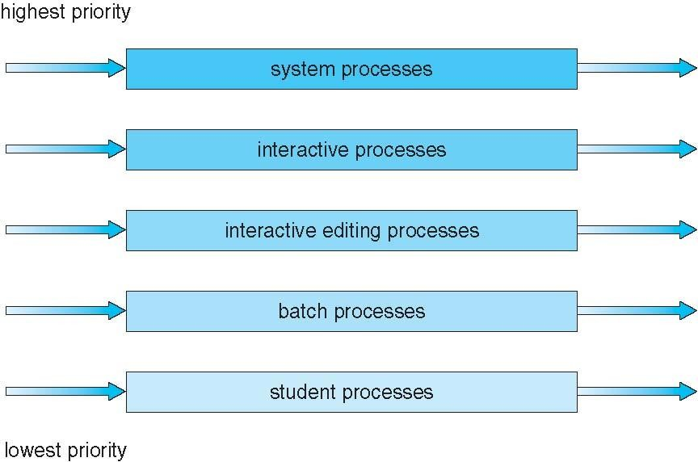
Multilevel Queue Scheduling

Slide 94
Multilevel Feedback Queue
A process can move between the various queues; aging can be implemented this way
Multilevel-feedback-queue scheduler defined by the following parameters:
number of queues
scheduling algorithms for each queue
method used to determine when to upgrade a process
method used to determine when to demote a process
method used to determine which queue a process will enter when that process needs service

Slide 95
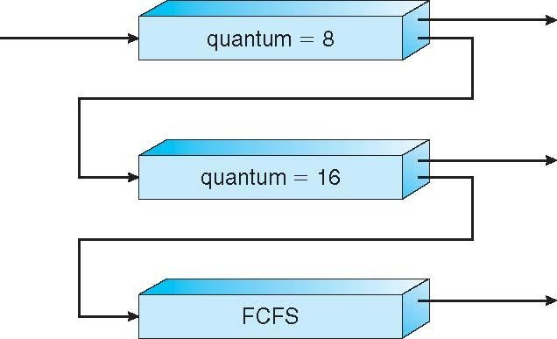
Example of Multilevel Feedback Queue
Three queues:
Q₀ – RR with time quantum 8 milliseconds
Q₁ – RR time quantum 16 milliseconds
Q₂ – FCFS
Scheduling
A new job enters queue Q₀ which is served FCFS
When it gains CPU, job receives 8 milliseconds
If it does not finish in 8 milliseconds, job is moved to queue Q₁
At Q₁ job is again served FCFS and receives 16 additional milliseconds
If it still does not complete, it is preempted and
moved to queue Q₂

Slide 96
Multilevel Feedback Queue
Concept — Processes are scheduled as per their category, and if required moved up/down between the queues.
Working
The different ready queues (0 .. n-1) are based on different CPU burst characteristics (i.e time quantum = 8, 16, 24 etc) and are ordered in ascending order of their time quantum's (i.e short CPU burst is high priority).
Each process entering the system is placed in ready queue0.
Scheduler executes the processes in ready queue0,
if any process requires more CPU time, it is moved to ready queue with lower priority (next below ready queue).
Scheduler first executes all processes in ready queue0,
if it is empty, executes the processes in the next level ready queue. If scheduler is executing a process in ready queue 1 and a process arrives in ready queue0, then process of ready queue0 preempts process of ready queue 1.

Slide 97
Multilevel Feedback Queue
Observations
It gives highest priority to any process with small CPU burst.
The parameters that define this scheduler are :
No. of queues; Scheduling Algorithm of each Queue; Methods to upgrade and demote a process between queues, method to decide where to place the process on entry
It is the most general scheduling algorithm.

Slide 98
Multiple-Processor Scheduling
CPU scheduling more complex when multiple CPUs are available
Asymmetric multiprocessing – only one processor accesses the system data structures, improving the need for data sharing
Symmetric multiprocessing (SMP) – each processor is self- scheduling, all processes in common ready queue, or each has its own private queue of ready processes
Currently, most common

Slide 99
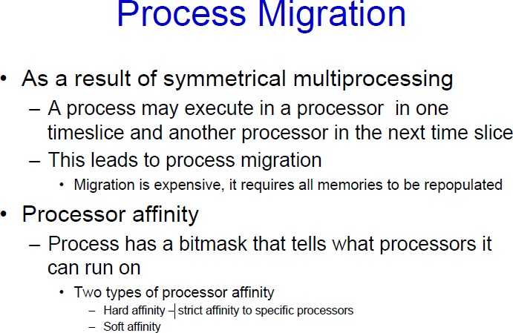

Slide 100
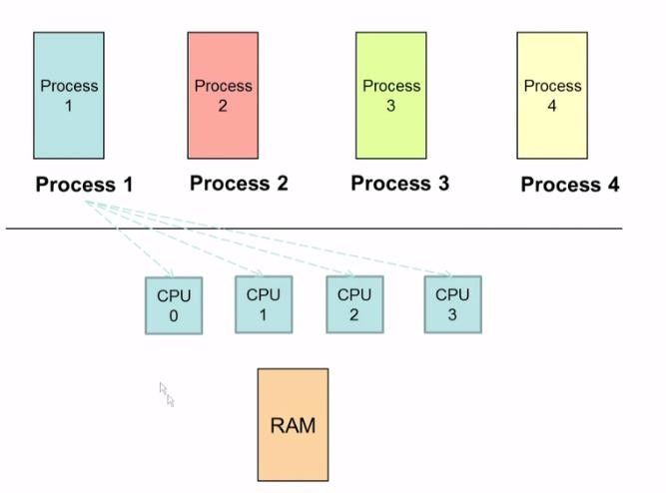
Multiple-Processor Scheduling

Slide 101
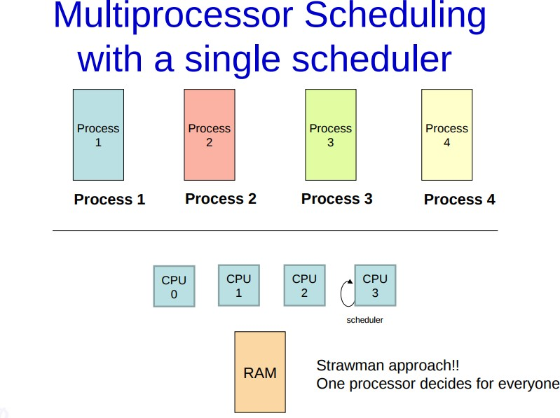

Slide 102
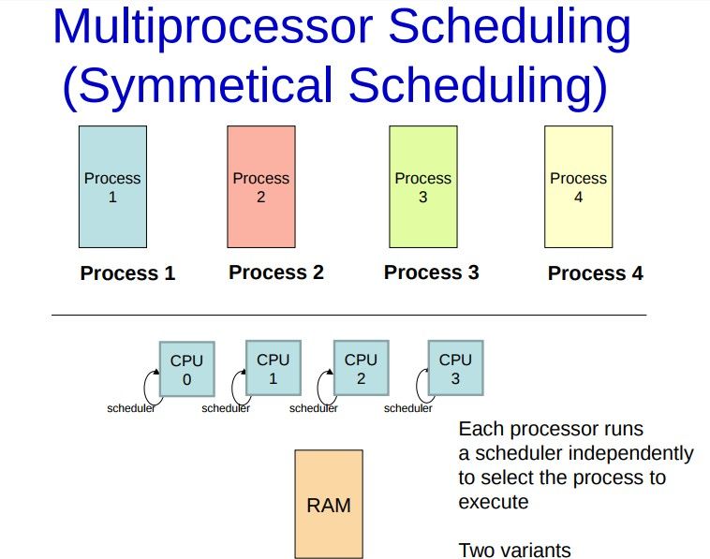

Slide 103
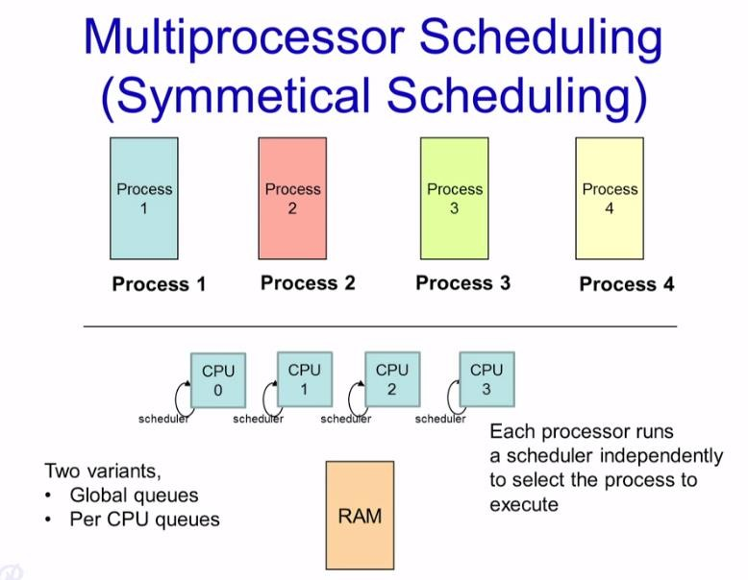

Slide 104
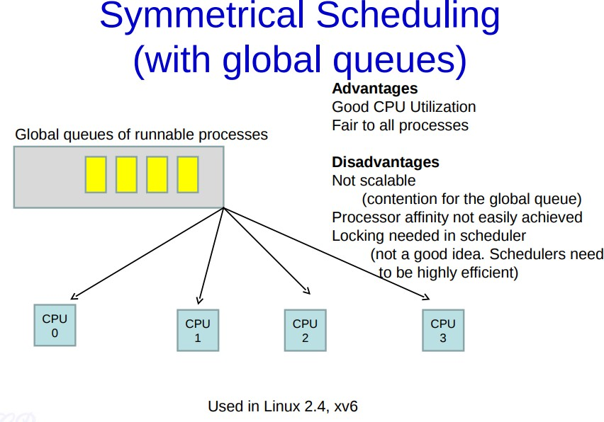

Slide 105
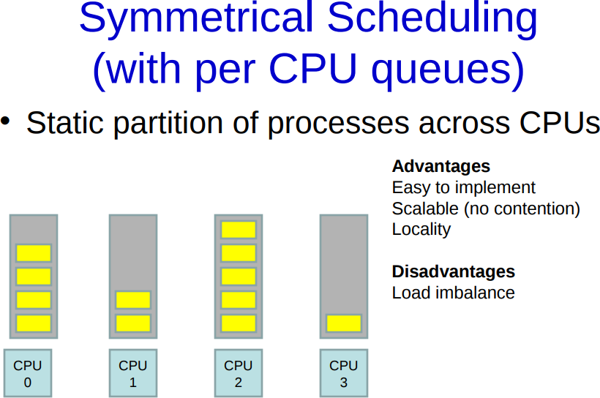

Slide 106
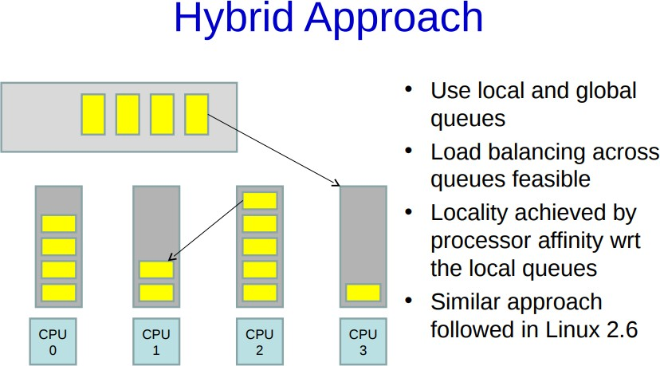

Slide 107
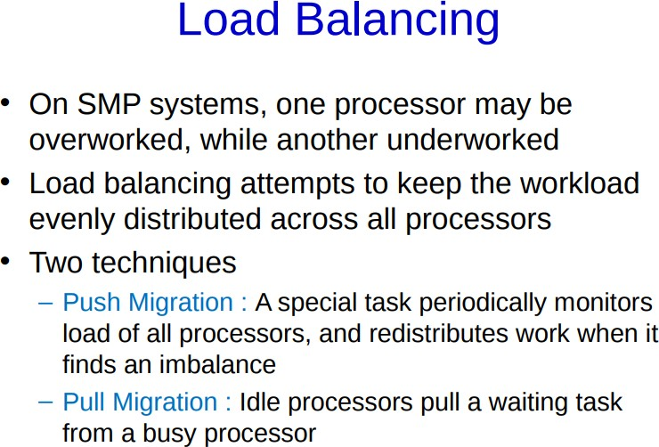

Slide 108
Multicore Processors
Recent trend to place multiple processor cores on same physical chip
Faster and consumes less power
Multiple threads per core also growing
Takes advantage of memory stall to make progress on another
thread while memory retrieve happens

Slide 109
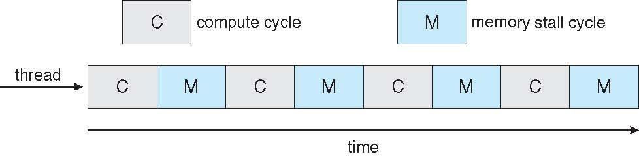

Multithreaded Multicore System

